Slide 1
DS3 Mini Project

Slide 2

HELLO!
We are Batch 06.
B18064 KHYATI AGARWAL
B18045 AKSHIT KUMAR
B18057 HRIDAYESH AKHAND
B18065 KSHITIZ JAIN
B18084 SAATVIK CHUGH
B18062 KAIRAV BANSAL

Slide 3
Data description
1

Slide 4
About our Dataset
This dataset contains data of several patients in the US refilling different medications from pharmacies.
Each row in data is a patient who refills a particular medicine.

Slide 5
(11700,16)
is the shape of dataset.

Slide 6
0
“int64”
7105
There are no missing values in the data.
data types of all attributes.
points in Class 2 and 4595 points in Class 1.

Slide 7
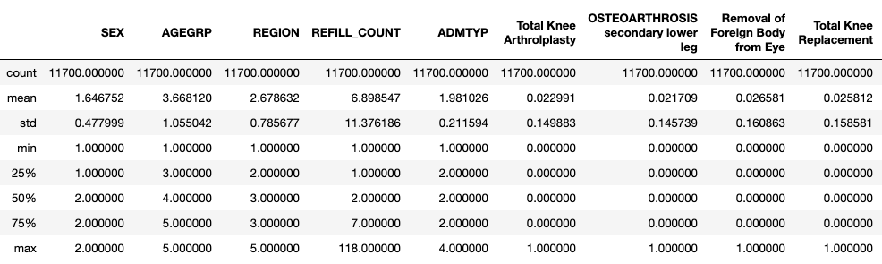
Description
→
Contd…

Slide 8
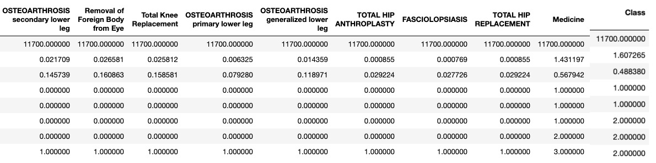
←

Slide 9
SEX 0.044 AGEGRP -0.014 REGION 0.009 REFILL_COUNT -0.58 ADMTYP -0.00098 Total Knee Arthrolplasty 0.0089 OSTEOARTHROSIS secondary lower leg 0.011 Removal of Foreign Body from Eye 0.0089 Total Knee Replacement 0.0013 OSTEOARTHROSIS primary lower leg 0.027 OSTEOARTHROSIS generalized lower leg -0.013 TOTAL HIP ANTHROPLASTY 0.024 FASCIOLOPSIASIS 0.022 TOTAL HIP REPLACEMENT 0.024 Medicine 0.22
Feature subset Selection
Correlation with target attribute(class)

Slide 10
Correlation with Class
Refill_Count is highly negatively correlated with the class attribute.
Pearson Correlation Coefficient between Class and Refill_Count = -0.58.

Slide 11
Problem statements
2

Slide 12
Given Problem
Perform the data cleaning if required. Perform the descriptive analytics to understand the data and infer from the data.
Perform the predictive analytics (classification) on predicting the whether the patient is frequent buyer of medicine or not. Use different classification techniques and compare the results. Perform the data pre-processing (normalization, standardization, correlation analysis & feature section, dimension reduction using PCA) and compare the results of classification with unprocessed data.
Consider 70% of data from each class for training and remaining 30% of data from each class for testing.
Infer the results obtained from descriptive and predictive analytics.

Slide 13
Our Approach
First we clean the data and perform descriptive analytics to understand the data.
Then we perform the predictive analytics (classification) and data pre-processing and afterwards compare the results of classification with unprocessed data.
Lastly, we infer the results obtained from descriptive and predictive analytics.

Slide 14
Descriptive Analytics
3

Slide 15
Correlation Heatmap

Slide 16
Now a deeper look!
Attributes highly dependent on each other (i.e. correlation coefficient > 0.5) are redundant.
We can see there are many redundant attributes in the heatmap.
For feature selection, we will remove these redundant attributes.

Slide 17
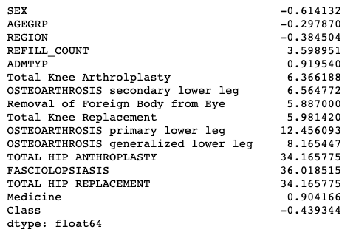
Now a deeper look!
Skew refers to a distribution that is assumed Gaussian (normal or bell curve) that is shifted or squashed in one direction or another.
We can see that SEX , AGEGRP and REGION resemble gaussian distribution.

Slide 18
Our process is easy
Data Cleaning
Descriptive Analytics
Pre-processing of Data
Predictive Analytics
Replace missing values and outliers in the data.
Correlation Analysis and Skew.
Normalization, Standardization, PCA, Feature selection.
KNN, Bayesian and Gaussian Mixture Model.

Slide 19
Cleaning & Pre-processing of Data
4

Slide 20
General idea
Removing Null Values
Replacing outliers with a central tendency
PCA, standardization , Normalization

Slide 21
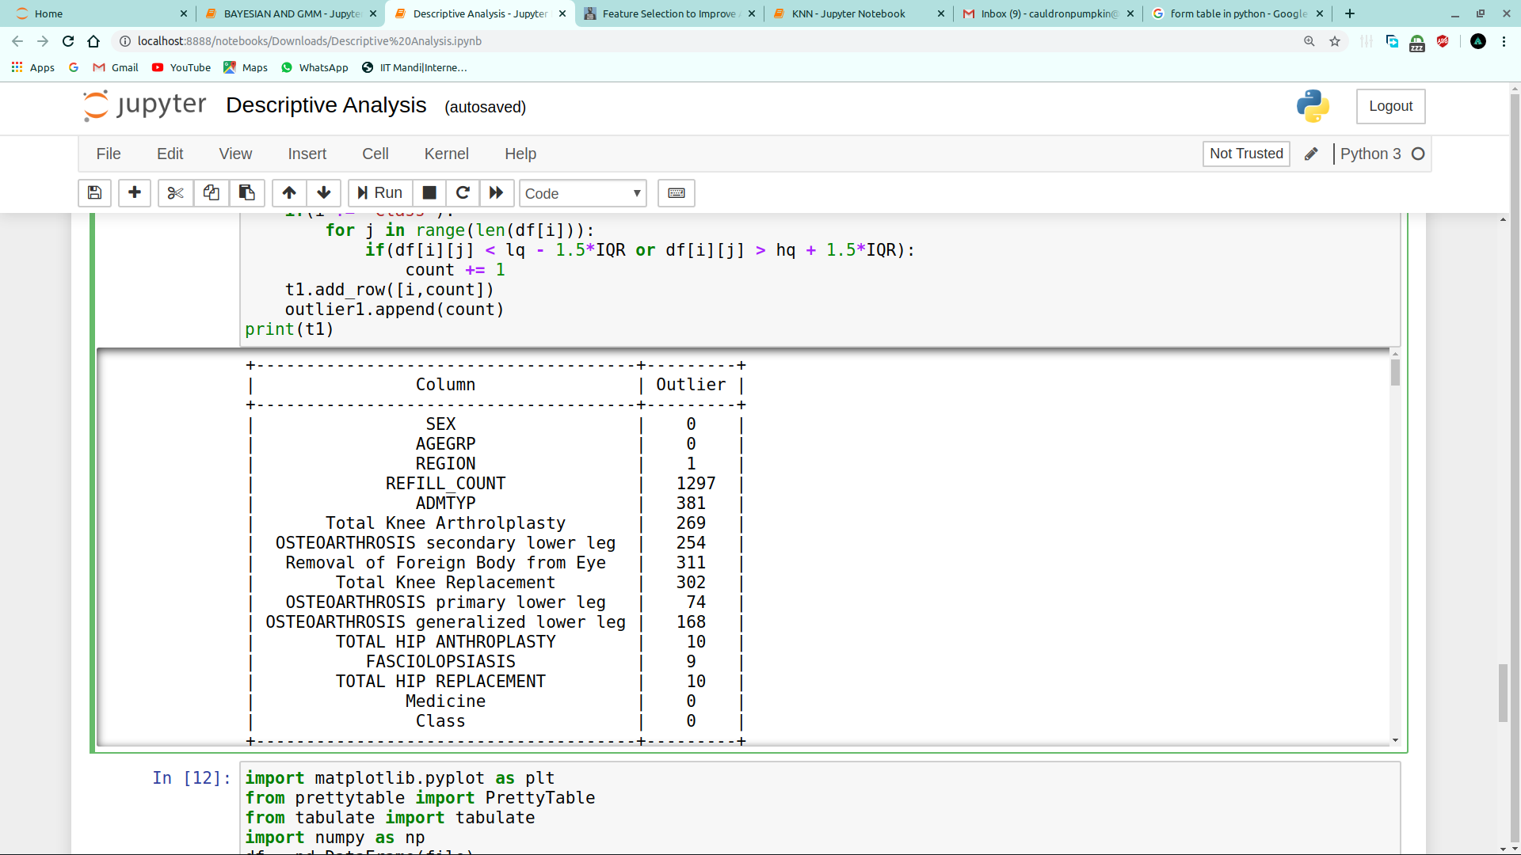
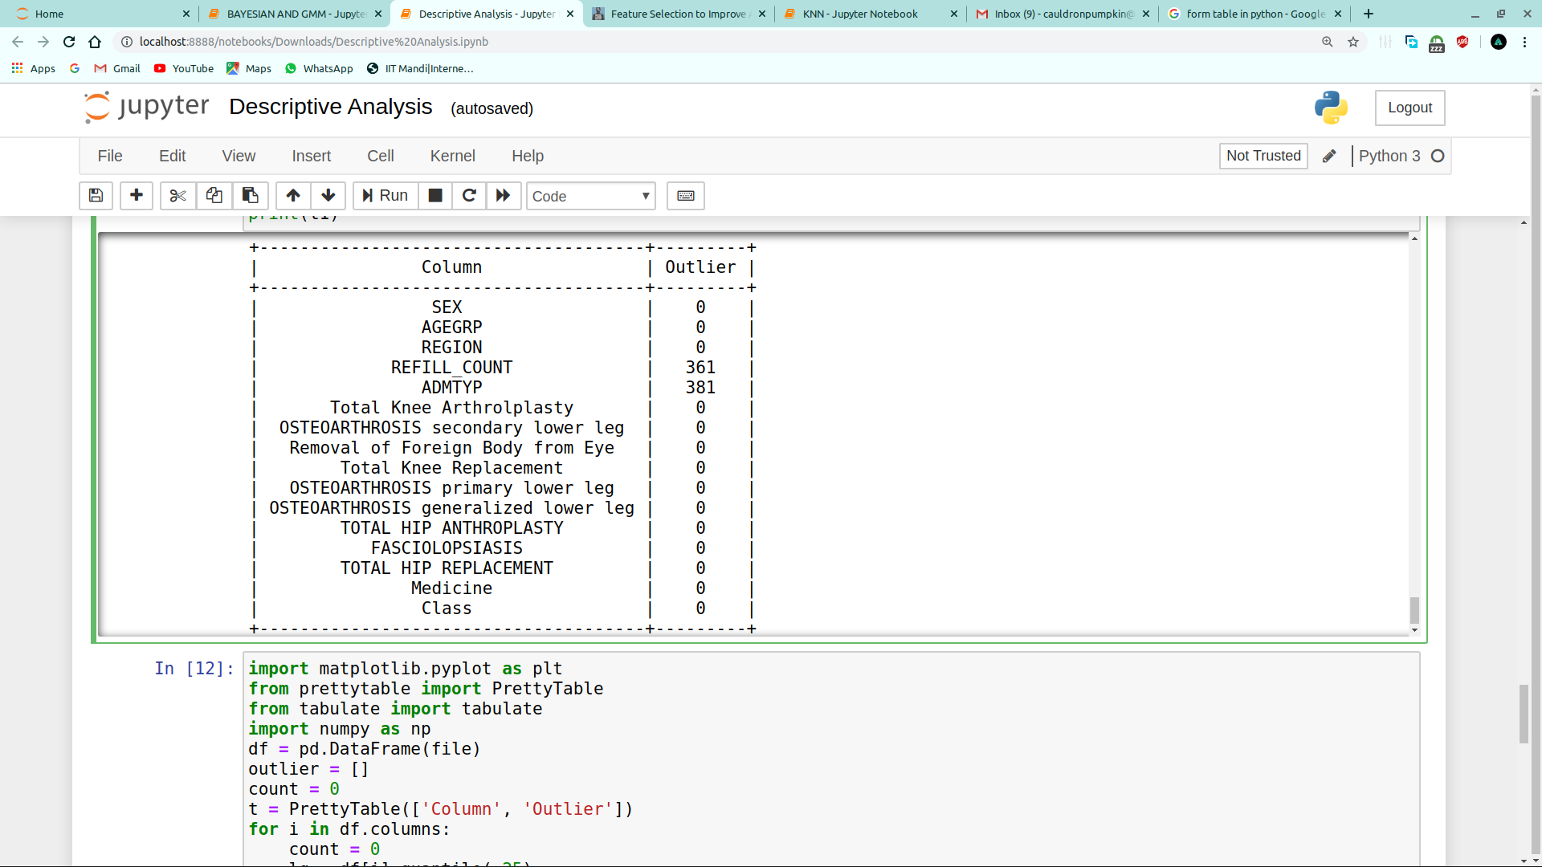
Observation
Central Tendency : Mean
→

Slide 22
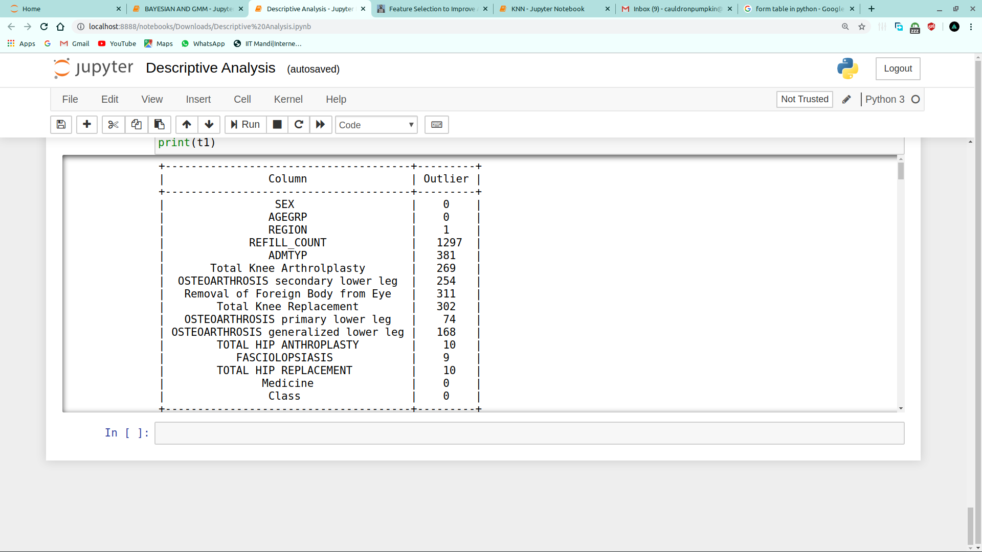
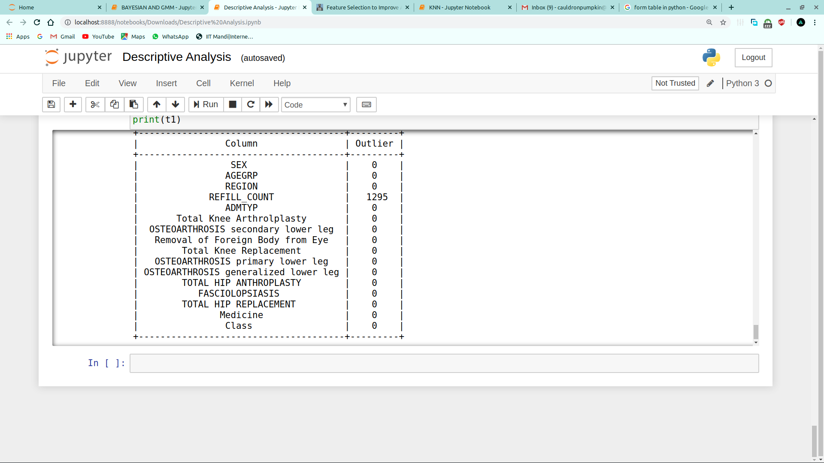
Central Tendency : Median
→

Slide 23
Outliers
Boxplot for Refill_count
Original data → Outliers removed with mean
→
25th quartile 1
Median 2
75th quartile 7
25th quartile 1
Median 2
75th quartile 6

Slide 24
Inferences
1.
After replacing the outliers with mean, we observe the number of outliers for most of the attributes become zero.
2.
Not all the outliers in every attributes are removed .
Because of the revised quartile range and median after removal of outliers.
3.
After the removal of outliers,
The analysis and classification
Becomes more efficient and accurate.

Slide 25
Predictive Analytics
5

Slide 26
KNN
K-NN classification is a supervised ML-algorithm (both input and output).
The KNN algorithm assumes that similar things exist in close proximity.
In KNN, the class most common amongst its K nearest neighbors measured by a distance function is assigned.

Slide 27
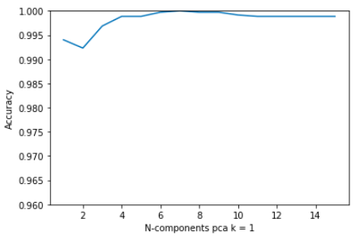
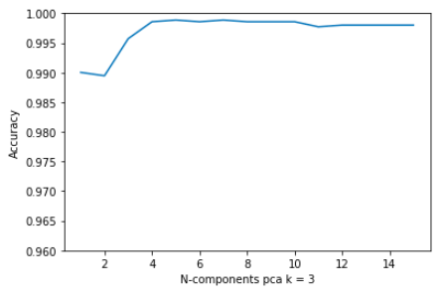
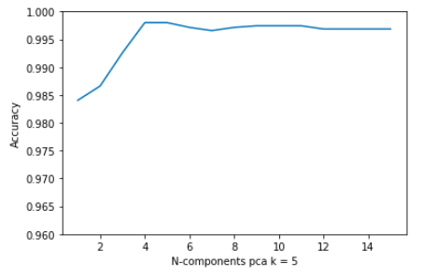
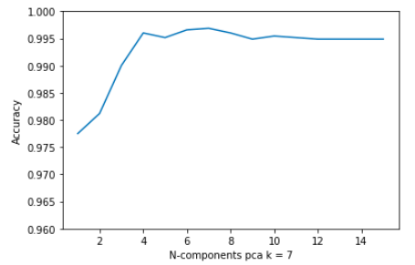
Observations – PCA
K = 1
K = 3
K = 5
K = 7

Slide 28
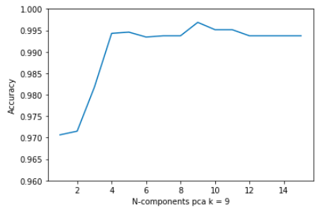
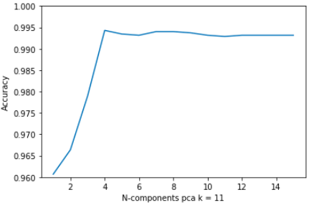
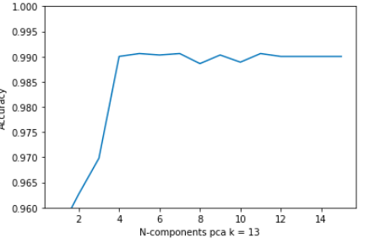
Observations
K = 9
K = 11
K = 13

Slide 29
Observations
We chose k=5 , to prevent overfitting and underfitting of train data.

Slide 30
Inferences
1.
For k=1, we get the maximum accuracy.
Reducing n-components to n=5 , the accuracy remains same almost.
2.
The accuracy on original data is a little more as compared to processed data.
3.
The algorithm gets significantly slower as the number of variables increase.
As KNN is a lazy learner.

Slide 31
GMM
The Gaussian Mixture Model Classifier (GMM) is basic but useful supervised learning classification algorithm that can be used to classify a wide variety of N-dimensional signals.

Slide 32
Observations - PCA
Q = 2
Q = 1
Q = 3

Slide 33
Q = 5
Q = 4
Q = 6

Slide 34
Observations

Slide 35
Inferences
The Maximum accuracy for Standardised and Normalised Data is greater than Original data.
After removing redundant columns, the accuracy of feature selection surpasses that of Original Data.
The Accuracy of Skewed Data is less because the columns with high correlation with label attribute are removed.

Slide 36
Comparative Results
6

Slide 37
A Different Vision GMM fits the data better.
 | Accuracy | True Positive | True Negative
KNN | ~0.99 | 1360 | 2145
GMM | ~0.99 | 1365 | 2137

Slide 38
Conclusion
Unprocessed Data Processed Data
For KNN ,accuracy is almost same in processed and unprocessed data.
But for Bayes Classifier and GMM ,accuracy is better in case of processed data.
 | Accuracy
KNN (k=5) | 0.999
Bayes Classifier | 0.92
Gmm | 0.945
 | Accuracy
KNN (k=5 , PCA=5) | 0.997
Bayes Classifier | 0.97
GMM | 0.998

Slide 39
We’re a bit of a freak for evidence-based analysis. We strongly believe in data.

Slide 40
THANKS!

